Slide 1
DATA PROFESSIONAL
SURVEY BREAKDOWN
An Interactive Power BI Dashboard Project
Anjali Sharma | B.Tech AIDS | Aspiring Data Analyst

Slide 2
Project Objective: Transforming Survey Data into Actionable Career Intelligence
The data industry is one of the fastest-growing career domains, yet understanding compensation, skills, and challenges requires more than isolated statistics.
This project transforms 630+ raw survey responses from data professionals worldwide into an interactive Power BI dashboard, enabling exploration of trends across countries, roles, programming languages, and career satisfaction metrics.
630+
10
SURVEY RESPONDENTS
DATA DIMENSIONS
Key Questions the Dashboard Answers
■ Which data roles offer the highest average salaries?
■ Which programming languages are most preferred?
■ How satisfied are professionals with work-life balance?
■ How difficult is it to break into the data industry?
■ Which countries contribute the most survey responses?
Mission: Using Power BI, Power Query, DAX, and Excel, the dashboard converts raw survey data into meaningful insights that support career planning, workforce analysis, and business intelligence decisions.
02 / 08

Slide 3
The Business Problem: A Data Gap in Understanding the Data Industry
Organizations, aspiring data professionals, and recruiters face a critical information gap when making decisions about careers, hiring, and workforce strategy in the rapidly evolving data industry.
Salary Benchmarking Gap
Skill Demand Uncertainty
Career Satisfaction Blindspot
No centralized source to compare compensation across data roles, making it difficult for professionals to negotiate and for employers to remain competitive.
Aspiring professionals struggle to identify which programming languages and skills are most valued by employers in the current data job market.
Employers lack visibility into work-life balance and salary satisfaction trends, missing opportunities to improve retention and workplace culture.
The Solution: An Interactive Power BI Dashboard
This dashboard provides a centralized, interactive view that answers critical industry questions through dynamic visualizations. Users can filter by country and gender, explore salary trends by job title, analyze programming language preferences, gauge career difficulty perceptions, and measure satisfaction levels - all in a single, user-friendly interface.
03 / 08

Slide 4
Tools, Technologies & Dataset Architecture
Technology Stack
Dataset Features
Power BI
Feature | Description
Country | Respondent location
Gender / Age | Demographics
Job Title | Current data role
Annual Salary | Compensation range (USD)
Programming Language | Favorite tool/language
Satisfaction Ratings | Work-life & salary happiness
Difficulty Score | Ease of entering data field
Interactive dashboard and visualization platform
Power Query
Data cleaning and transformation engine
Microsoft Excel
Source data storage and initial processing
DAX
Data Analysis Expressions for dynamic KPIs
Key DAX Measures
Count of Survey Takers = COUNTROWS(Data)
Average Age = AVERAGE(Data[Current Age])
Average Salary = AVERAGE(Data[Average Salary])
Avg Work/Life Balance = AVERAGE(Data[Work/Life Balance])
Avg Salary Happiness = AVERAGE(Data[Salary Satisfaction])
Source: Anonymous survey of data professionals conducted June 2022. Dataset contains 630+ complete responses across 10+ dimensions.
04 / 08

Slide 5
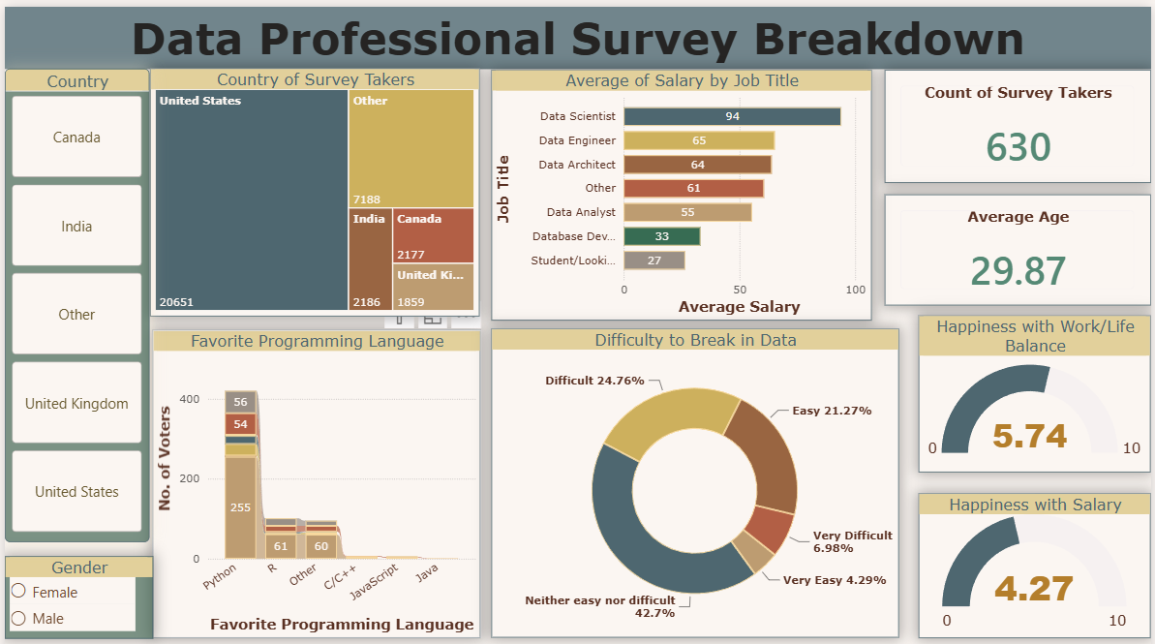
Dashboard Features: Interactive Visualizations & Dynamic KPIs
Dashboard Components
KPI CARDS
■ Count of Survey Takers
■ Average Age of Respondents
■ Happiness with Work/Life Balance
■ Happiness with Salary
INTERACTIVE FILTERS
■ Country selector (multi-select)
■ Gender filter (Male/Female)
VISUALIZATIONS
■ Treemap: Country distribution
■ Bar chart: Salary by job title
■ Donut chart: Break-in difficulty
630
29.87
5.74
4.27
TOTAL RESPONDENTS
AVERAGE AGE
WORK/LIFE BALANCE /10
SALARY HAPPINESS /10
05 / 08

Slide 6
Key Insights: Data Scientists Lead Salaries; Python Dominates Skills
Salary Insight: Data Scientists command the highest average salary at $94K, followed by Data Engineers ($65K) and Data Architects ($64K). Entry-level roles and students report significantly lower compensation, highlighting a clear experience-premium in the data industry.
Language Insight: Python is the dominant programming language with 255 votes, 4x more than R (61). SQL also ranks highly. JavaScript and Java received minimal preferences, suggesting data professionals prioritize analytical over general-purpose languages.
Source: Data Professional Survey, June 2022 (n=630). Salary values represent midpoint of reported ranges in USD thousands.
06 / 08

Slide 7
Career Satisfaction Lags Compensation; U.S. Dominates Global Responses
The United States overwhelmingly dominates with 20,651 responses, followed by Canada (2,186) and India (2,177). This concentration suggests the survey primarily reflects the North American data job market.
42.7% found breaking into data "neither easy nor difficult," while 31.7% found it difficult or very difficult. Only 25.6% considered it easy, highlighting the importance of practical skills and mentorship.
Career Satisfaction Comparison
5.74
Work/Life Balance Happiness /10
4.27
Salary Happiness /10
Above midpoint - generally positive perception
Below midpoint - significant compensation gap
07 / 08

Slide 8
BUSINESS RECOMMENDATIONS & OUTCOMES
01
02
03
Invest in Python Training
Python's 4x lead over other languages makes it essential for any data career path.
Benchmark Salaries Competitively
Data Scientists earn $94K avg - organizations must match market rates to attract talent.
Address the Compensation Gap
Salary satisfaction (4.27) lags work-life balance (5.74) - improve retention through better pay.
04
05
Build Mentorship Programs - 31.7% found breaking into data difficult; structured guidance reduces entry barriers.
Leverage Geographic Hiring - U.S., Canada, and India show strong data talent pools for recruitment.
SKILLS DEMONSTRATED
Data Cleaning | Power Query | DAX Measures | Data Modeling | Dashboard Design | Business Intelligence | Data Visualization | Analytical Thinking | Interactive Reporting
THANK YOU
Anjali Sharma | B.Tech AIDS (2023-2027)
Aspiring Data Analyst | Power BI | SQL | Python | Excel

